Slide 1
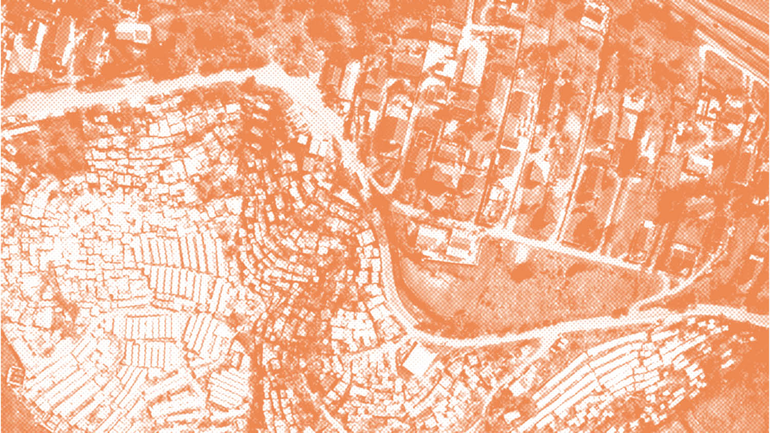



COMMONWEALTH SUSTAINABLE URBANISATION PROGRAMME INFRASTRUCTURE-LED COMMUNITY RESILIENCE
Hosted by
The Commonwealth Engineers Council
UNESCO
Institution of Civil Engineers
Co-Chairs Prof Paul Jowitt, President, CEC
Dr Peggy Oti-Boateng, Director of Science Policy, UNESCO
Panellists Dr Priti Parikh, University College, UK
Professor Murali Chandrashekaran, Vice Provost International, UBC, Canada
Thandeka Mlaza-Lloyd, Development Planning Unit, Johannesburg. Sth Africa
Dr Juliet Mian, Deputy Executive Director, The Resilience Shift, UK
Dr Josh Macabuag, Disaster Risk Engineer, Independent Consultant, UK
Notes:
Welcome to this webinar which is part of the Commonwealth Sustainable Urbanisation Programme The Webinar is hosted by The Commonwealth Engineers Council, UNESCO and the Institution of Civil Engineers
The focus is on Infrastructure-Led Community Resilience
My name is Paul Jowitt, President, Commonwealth Engineers Council. My Co-Host is Dr Peggy Oti-Boateng, who is the Director of Science Policy and Capacity Building at UNESCO. Peggy is a graduate of KNUST in Kumasi in Ghana
The Panellists are
Dr Priti Parikh, Director, Engineering for International Development (EFID), University College, UK
Professor Murali Chandrashekaran, Vice Provost International for UBC, Canada
Thandeka Mlaza-Lloyd, Development Planning Unit, Johannesburg. Sth Africa
Dr Juliet Mian, Deputy Executive Director, The Resilience Shift, UK
Dr Josh Macabuag, Disaster Risk Engineer, Independent Consultant, UK

Slide 2


Session Overview
Systems level solutions to build resilient and healthy communities through social and physical infrastructure.
Interdisciplinary collaborations for cities to better respond to future events
Green recovery and growth
Capacity building and skills development in engineering and related disciplines
Potential enablers: energy; ICT; water/sanitation, social networks, para-professionals etc.
Potential threats: pandemics such as Covid-19; climate change, natural disasters, ineffective institutions and poor governance etc.
Notes:
Session Overview
The session will focus on systems level approaches to building resilient and healthy communities through social and physical infrastructure.
I hope we will pick up Issues such as
Interdisciplinary collaborations
Opportunities for green recovery and growth
Capacity building and skills development in engineering and related disciplines
Potential enablers: energy; ICT; water/sanitation, social networks, para-professionals etc.
Potential threats: pandemics such as Covid-19; climate change, natural disasters, ineffective institutions and poor governance etc.

Slide 3
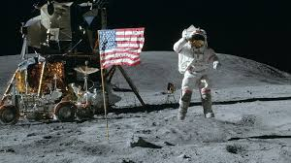
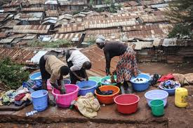
Landmark engineering projects versus systems level solutions to bring infrastructure to millions…??
Which is more difficult?
Putting men on the moon…
Or providing water and sanitation for the urban poor in Kibera?
Notes:
Many Cities at risk from natural disasters and disease are also often those where the underpinning infrastructure provision is poor or non-existent, with unsafe water, sanitation and solid waste disposal. Despite their apparent unattractiveness, they are often powerful magnets for migration and the source of endogenous population growth. They are also often characterised by poor local governance and a lack of legal tenure.
They represent a real systems problem. And they deserve the attention of Engineers and allied professions and other complementary professions to deliver systems level solutions.
It is common to think of landmark projects such as Manned Spaceflight to the Moon, the Burj Khalifa and the Millau Viaduct as complex engineering projects.
In 1962, President John F Kennedy said
“We choose to go to the moon in this decade, and do the other things, not because
they are easy, but because they are hard — because that goal will serve to organize and measure the best of our energies and skills — because that challenge is one that we are willing to accept, one we are unwilling to postpone, and one we intend to win.”
But on the scale of real complexity, real difficulty and real importance as we face an uncertain future, I would contend that landing a man on the Moon is far easier compared to the systems level thinking and systems level delivery at scale that is required to bring a functioning infrastructure platform to millions of ordinary people.

Slide 4
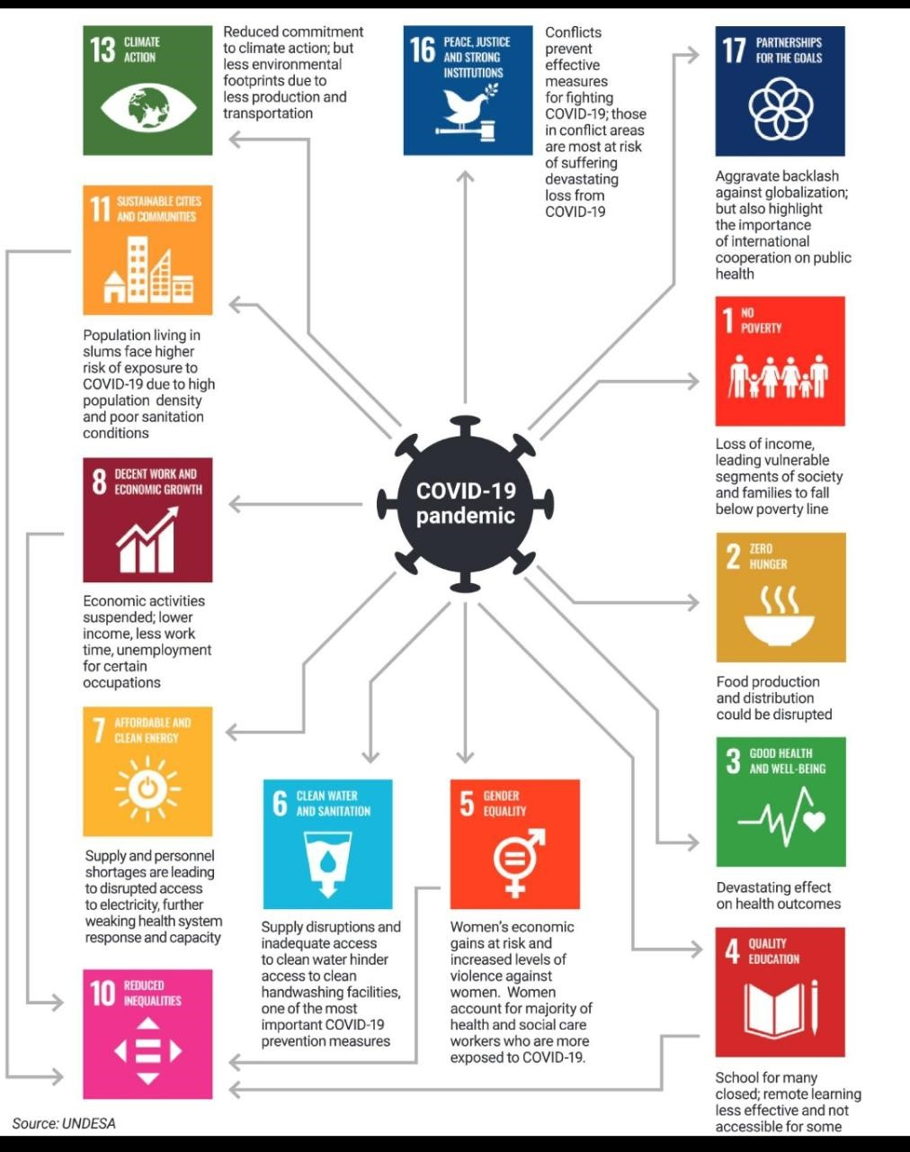
The Impact of Covid 19 on the UN SDGs…
Covid?
How quickly does it spread?
- Need to get R₀ < 1 , so the Pandemic dies out…
Other threats?
Earthquakes, Hurricanes?
The effects occur very quickly
Climate Change? Occurs relatively slowly – but the effects are locked in
But how quickly can we recover?
Notes:
With Covid 19, the focus has been on the value of R₀. Less than one and the pandemic dies out, greater than and it spreads rapidly.
We are now entering months 8, 9, 10, depending on where you are. The impacts will take time to overcome.
The effect of Earthquakes and Hurricanes is almost instantaneous. Resilience need to be built in. And for such as Climate Change, the causative events occur gradually over time, and the effects are locked in.
But in all cases, the recovery process is often slow.
Where this recovery process involves the provision of urban infrastructure (including the associated infrastructure services), the key question is how can the pace of that provision be quick enough to make a difference?

Slide 5
An Infrastructure “Pandemic” - What do we need? What do we need to do to deliver the UN SDGs…?
We need an Infrastructure Pandemic!
How quickly can it spread?
- Need to get R₀ > 1 , so that Infrastructure spreads!
Limiting Factors?
Not enough built environment professionals – engineers, architects, planners, surveyors
and para professionals
The role of
Effective Local Governance?
Communities?
and the diaspora?
An Infrastructure Pandemic
Notes:
The Built Environment Professions have a key role to play, but we also know from the Commonwealth Survey that their presence is often thin on the ground. How do we address that? How can the skills of the diaspora be engaged? How can other actors in the Municipalities be involved?
If we were to model the spread of functioning infrastructure in the same way as a pandemic, we would want the equivalent of R₀ to be greater than one, not less.
It’s nowhere near one…
The rate of unplanned urban growth outstrips our ability to build safe and sustainable infrastructure.
That is the challenge we face
That is the challenge we face
We need to provide infrastructure at a pandemic rate

Slide 6
The Challenge we face – Scaling it up…
Now over to my colleagues…
Co-Chairs Dr Peggy Oti-Boateng, Director of Science Policy, UNESCO
Panellists Dr Priti Parikh, University College, UK
Professor Murali Chandrashekaran, Vice Provost International, UBC, Canada
Thandeka Mlaza-Lloyd, Development Planning Unit, Johannesburg. Sth Africa
Dr Juliet Mian, Deputy Executive Director, The Resilience Shift, UK
Dr Josh Macabuag, Disaster Risk Engineer, Independent Consultant, UK

Slide 7
COMMONWEALTH SUSTAINABLE URBANISATION PROGRAMME INFRASTRUCTURE-LED COMMUNITY RESILIENCE
Hosted by
The Commonwealth Engineers Council
UNESCO
Institution of Civil Engineers
Dr Peggy Oti-Boateng
Director of Science Policy, UNESCO

Slide 8

UNESCO and the SDGs A call to action across the Commonwealth
International Collaboration on Engineering for the Sustainable Development Goals
Building a Global Consensus on Engineering for Society

Slide 9

UNESCO at the Heart of the Sustainable Development Goals
Building peace in the minds of men and women through Education the Sciences Culture and Communication and Information
In the context of pressing planetary and socio-economic challenges, sustainable and innovative solutions require an efficient, transparent and vibrant scientific and engineering community not only stemming from scientists and engineers but from the whole of society and leaving no one behind

Slide 10
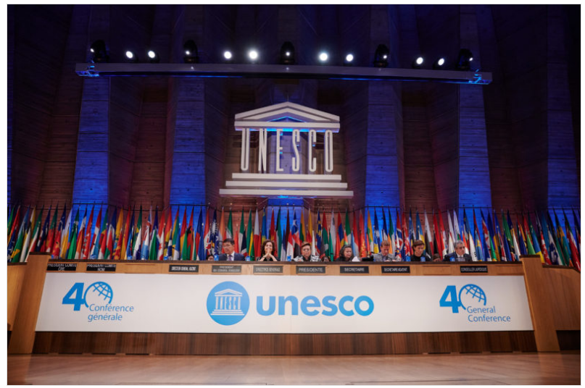
Proclamation of World Engineering Day for SD
A global understanding and importance of engineering and technology as central to modern life and sustainable development and showcasing the opportunities in Engineering
At the UNESCO 40th General Conference, 193 Members States of UNESCO Proclaimed 4th March as World Engineering Day for Sustainable Development
Highlights the achievements of engineers and engineering in our world
UNESCO 40th Session of the General Conference

Slide 11
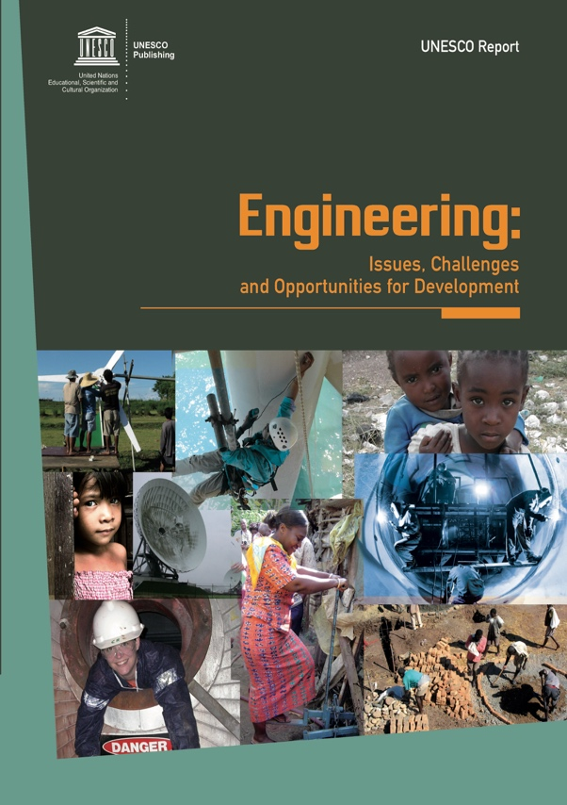
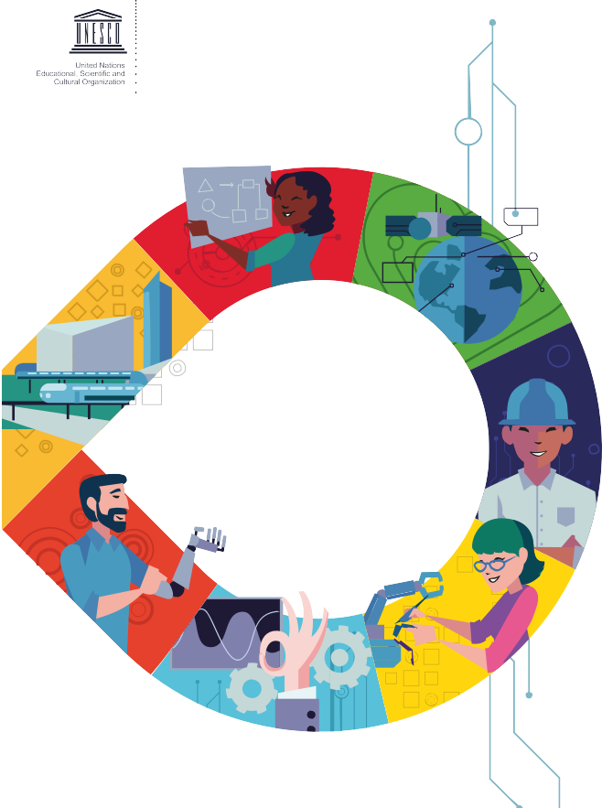
Monitoring Engineering the SDGs-UNESCO Report
Engineering report 2 embodies transformation to ensure that engineering drives and enables the achievement of the United Nations Sustainable Development Goals for the benefits of all.
Engineering the SDGs 2020

Slide 12
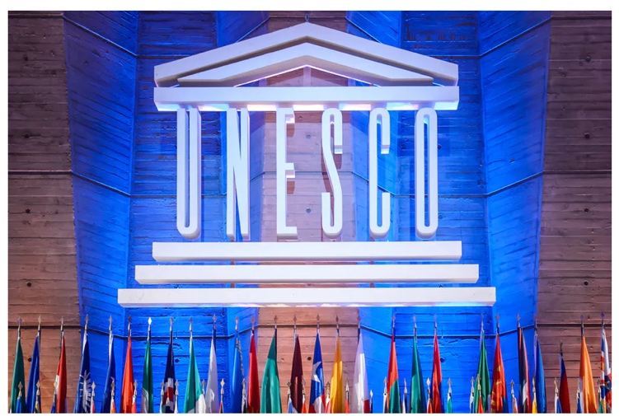



UNESCO Science & Engineering - Diversity and Inclusion
Join UNESCO Science and Engineering partnership for the SDGs with Women and Girls at the core !
JOIN THE COMMONWEALTH SUSTAINABLE URBANISATION PROGRAMME

Slide 13
COMMONWEALTH SUSTAINABLE URBANISATION PROGRAMME INFRASTRUCTURE-LED COMMUNITY RESILIENCE
Hosted by
The Commonwealth Engineers Council
UNESCO
Institution of Civil Engineers
Dr Priti Parikh, University College London, UK
Engineering for International Development Centre, @pritiparikh73

Slide 14
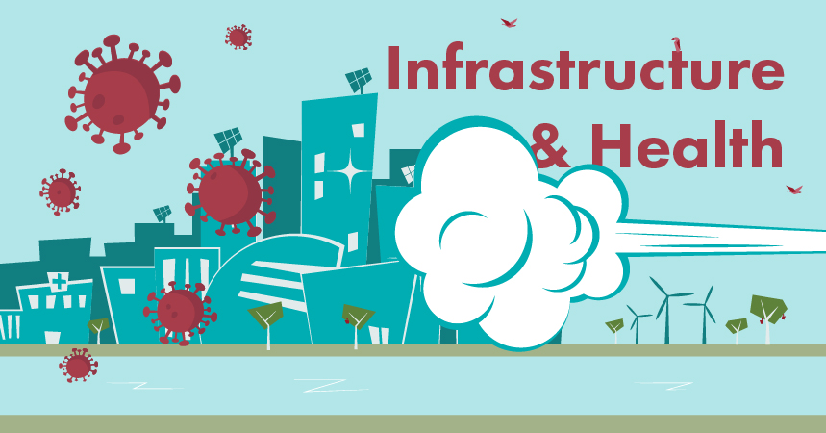
Challenges facing Cities in light of COVID-19
Image Credit: Happold Foundation City Conversations
Notes:
COVID-19 has transformed the way in which we interact with our cities bringing health and behavioral science to the heart of planning processes. It raises questions on densities in cities – which by itself if planned well is not a challenged, it also brings to the forefront existing inequities in our cities - highlights multiple and complex vulnerabilities. The pandemic therefore provides us an opportunity to address existing imbalances, gaps in infrastructure with equity and well-being being the centerpiece. Moving forward COVID-19 provides an opportunity to build resilient and health communities through social and physical infrastructure.

Slide 15
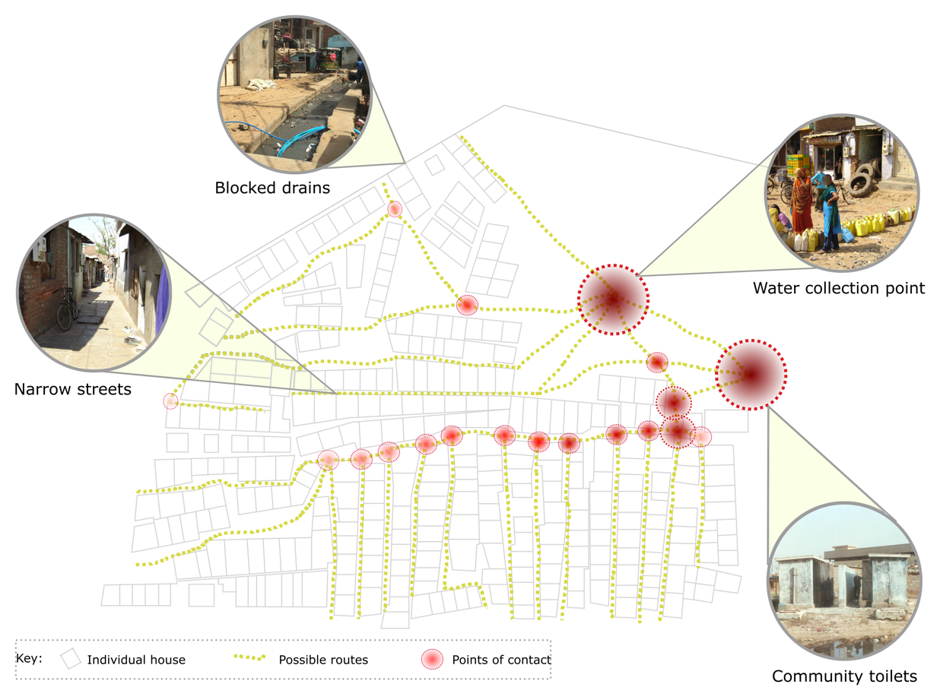
Infrastructure and COVID-19 links in informal settlements
Parikh, priti, et al. "COVID-19 and Informal Settlements-Implications for Water, Sanitation and Health in India and Indonesia." UCL Open: Environment Preprint. CHIP Consortium see https://www.acesoghc.com/chip
Notes:
For example taking the context of informal settlements which house a billion people, even on a day to day basis accessing basic infrastructure needs is a challenge. Physical distancing is impossible due to over-crowding, and accessing water and sanitation services in a lockdown setting requires access to communal points resulting in multiple transmission pathways and contact points. As Paul highlighted earlier if we can send a man to the moon – perhaps it is time now to address the needs of local communities on our planet through sustainable and resilient infrastructure.

Slide 16
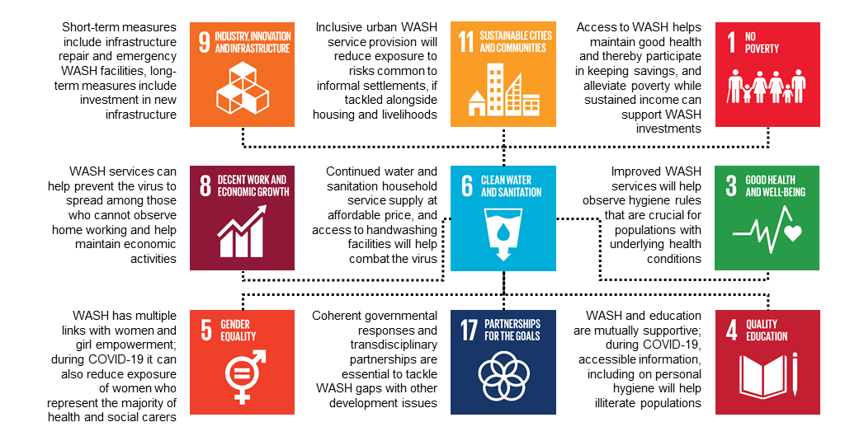
WASH, SDGS and COVID-19 links in informal settlements
Parikh, Diep, Gupte, Lakhanpaul (2020) COVID-19 Challenges and WASH in Informal Settlements: Integrated Action Supported by the Sustainable Development Goals, Cities.
Notes:
This is where the SDGS provide an unifying framework for holistic interventions which will break down disciplinary silos. For example WASH provision in informal settlements directly impact at least 9 SDGS and will result in improved health, education, economic opportunities, poverty reduction, equity and sustainable cities. This requires cross-sectoral partnerships.

Slide 17
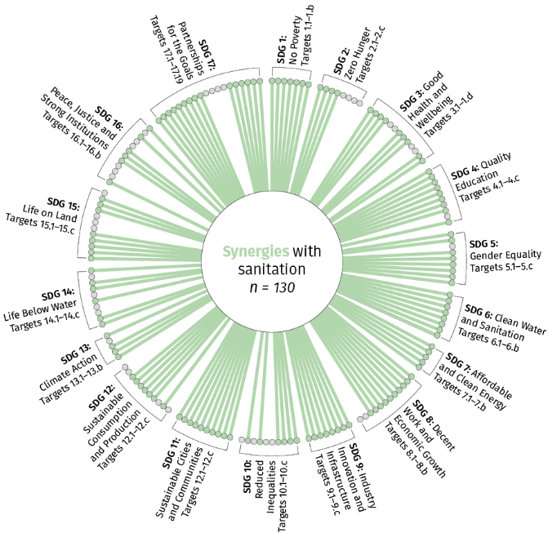
SDGs - Unifying Framework
Parikh, Diep, Hoffman, Tomei, Campos, Teh, Mulugetta, Milligan, Lakhanpaul (n.d.) Mapping Synergies and Trade-Offs between Sanitation and the Sustainable Development Goals
Notes:
I lead an interdisciplinary team at UCL where through evidence base mapping we demonstrate that action in sanitation can benefit 130 out of the 169 SDG Targets. This demonstrates that investment in infrastructure can lead to wide ranging benefits, support systems approaches, help harmonise policies, help to leverage investments across sectors – which is vital as there will be multiple demands on resources moving forward. Also the challenges that we will need to address moving forward are messy, complex and we will all need to work together.

Slide 18
Role of Engineers in the 21st Century
Interdisciplinary teams
Cross-sectoral collaborations
UCL Engineering for International Development
Mixed methods: Tech and society
Capacity building and skills development in engineering and related disciplines (Parikh and Matthews, ICE Civil Engineering)
Support SDGs through infrastructure investment
Notes:
Why interdisciplinary is important – to address global challenges, bring disciplines like health, behavioral sciences, social sciences to the heart of planning processes. In order to deliver resilient infrastructure engineers will need to integrate technical and societal needs. At UCL I set up a new MSc – Engineering and International Development which was about creating a new generation of engineers who can use mixed methods, collaborate across sectors in interdisciplinary teams and engage with local communities. Resilient and sustainable infrastructure provides a vehicle to support the SDGs.

Slide 19
COMMONWEALTH SUSTAINABLE URBANISATION PROGRAMME INFRASTRUCTURE-LED COMMUNITY RESILIENCE
Hosted by
The Commonwealth Engineers Council
UNESCO
Institution of Civil Engineers
Dr Murali Chandrashekaran
Vice Provost International, University of British Columbia;
Urban Resilience Senior Research Fellow, Global Network for Advanced Management
Notes:
Welcome etc
Co-Chairs
1. Prof Paul Jowitt, President, Commonwealth Engineers Council, UK
2. Dr Peggy Oti-Boateng, Director of Science Policy and Capacity Building, UNESCO, Ghana
Panellists
1. Dr Priti Parikh, Director, Engineering for International Development (EFID), University College, UK
2. Professor Murali Chandrashekaran, Vice Provost International for UBC, Canada
3. Dr Josh Macabuag, Disaster Risk Engineer, Independent Consultant, UK
4. Thandeka Mlaza-Lloyd, Development Planning Unit, City of Johannesburg

Slide 20
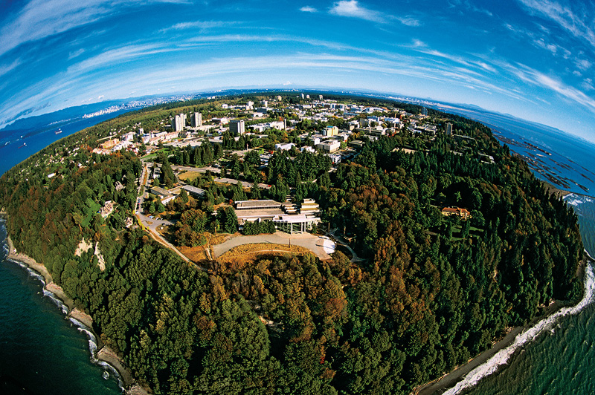

Slide 21
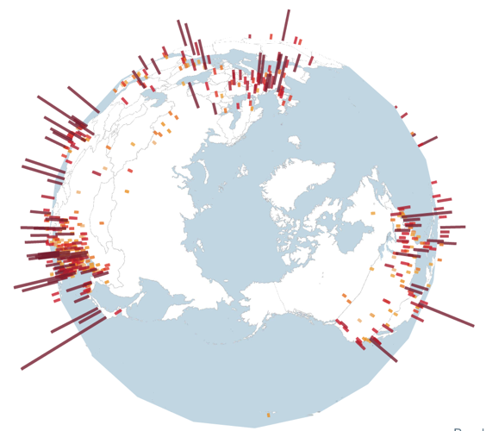
Themes relevant well prior to COVID-19
2% urban in 1800
30% in 1950
70% by 2050
65% of global GDP from 600 cities
1 billion in informal settlements
Economic, social and environmental divides
Notes:
Many Cities at risk from natural disasters and disease are also often those where the underpinning infrastructure provision is poor or non-existent, with unsafe water, sanitation and solid waste disposal. Despite their apparent unattractiveness, they are often powerful magnets for migration and the source of endogenous population growth. They are also often characterised by poor local governance and a lack of legal tenure.
They represent a real systems problem. And they deserve the attention of Engineers and allied professions and other complementary professions to deliver systems level solutions.
It is common to think of landmark projects such as Manned Spaceflight to the Moon, the Burj Khalifa and the Millau Viaduct as complex engineering projects. But on the scale of real complexity and real importance as we face an uncertain future, they pale into insignificance compared to the systems level thinking and systems level delivery at scale that is required to bring a functioning infrastructure platform to millions of ordinary people.

Slide 22
Complex systems – points of view & multiple voices
Finance Technology
Capacity development
Trade, Policy & institutional coherence
Multi-stakeholder partnerships
Data, monitoring and accountability
Case studies/ replications
Stockholm Resilience Centre
Notes:
Many Cities at risk from natural disasters and disease are also often those where the underpinning infrastructure provision is poor or non-existent, with unsafe water, sanitation and solid waste disposal. Despite their apparent unattractiveness, they are often powerful magnets for migration and the source of endogenous population growth. They are also often characterised by poor local governance and a lack of legal tenure.
They represent a real systems problem. And they deserve the attention of Engineers and allied professions and other complementary professions to deliver systems level solutions.
It is common to think of landmark projects such as Manned Spaceflight to the Moon, the Burj Khalifa and the Millau Viaduct as complex engineering projects. But on the scale of real complexity and real importance as we face an uncertain future, they pale into insignificance compared to the systems level thinking and systems level delivery at scale that is required to bring a functioning infrastructure platform to millions of ordinary people.

Slide 23

Complex systems require multiple voices
Collaborative on Urban Resilience and Effectiveness
Colleges
Cities
Corporates
Communities
Research
Use-inspired research
Clusters across faculties & universities
Pedagogy
Experiential learning pathways
Cross-continent and cross scholastic
Capacity building
Resilience professionals
Deep-dive topical areas
Knowledge exchange
Case studies/ replications
Metrics and Indices
Notes:
Many Cities at risk from natural disasters and disease are also often those where the underpinning infrastructure provision is poor or non-existent, with unsafe water, sanitation and solid waste disposal. Despite their apparent unattractiveness, they are often powerful magnets for migration and the source of endogenous population growth. They are also often characterised by poor local governance and a lack of legal tenure.
They represent a real systems problem. And they deserve the attention of Engineers and allied professions and other complementary professions to deliver systems level solutions.
It is common to think of landmark projects such as Manned Spaceflight to the Moon, the Burj Khalifa and the Millau Viaduct as complex engineering projects. But on the scale of real complexity and real importance as we face an uncertain future, they pale into insignificance compared to the systems level thinking and systems level delivery at scale that is required to bring a functioning infrastructure platform to millions of ordinary people.

Slide 24
Youth leadership – Cross-disciplinary, cross-institutional, cross-continental
Globally-inspired but locally-relevant – LOCAL VOICE MATTERS
Role of networks – WHO IS THE STAR AND WHO ARE PLANETS?
Thriving communities – MSMEs & INCLUSION
Sustainable funding for projects in informal settlements – RATIONAL BUSINESS CASE
Informed resource allocation – METRICS & VALUATION
Knowledge sharing – TELLING STORIES
Notes:
Session Overview
The session will focus on systems level approaches to building resilient and healthy communities through social and physical infrastructure.
Interdisciplinary collaborations are required for cities to better respond to future events
Opportunities for green recovery and growth
Capacity building and skills development in engineering and related disciplines
Potential enablers: energy; ICT; water/sanitation, social networks, para-professionals etc.
Potential threats: pandemics such as Covid-19; climate change, natural disasters, ineffective institutions and poor governance etc.

Slide 25
COMMONWEALTH SUSTAINABLE URBANISATION PROGRAMME INFRASTRUCTURE-LED COMMUNITY RESILIENCE
Hosted by
The Commonwealth Engineers Council
UNESCO
Institution of Civil Engineers
Ms Thandeka Mlaza-Lloyd
Assistant Director: City Transformation and Spatial Planning_Development Planning
City of Johannesburg, South Africa
BEITT Member

Slide 26
INFRASTRUCTURE-LED COMMUNITY RESILENCE
RESILIENT COMMUNITIES
LOCAL GOVERNMENT
NATIONAL GOVERNMENT
COMMUNITIES
PRIVATE SECTOR
CIVIL ORGANISATIONS
PROVINCIAL GOVERNMENT
SOUND POLICY FRAMEWORK THAT ENABLES AN ALL OF GOVERNMENT APPROACH
SOUND POLICY FRAMEWORK THAT ENABLES AN ALL OF GOVERNMENT APPROACH

Slide 27
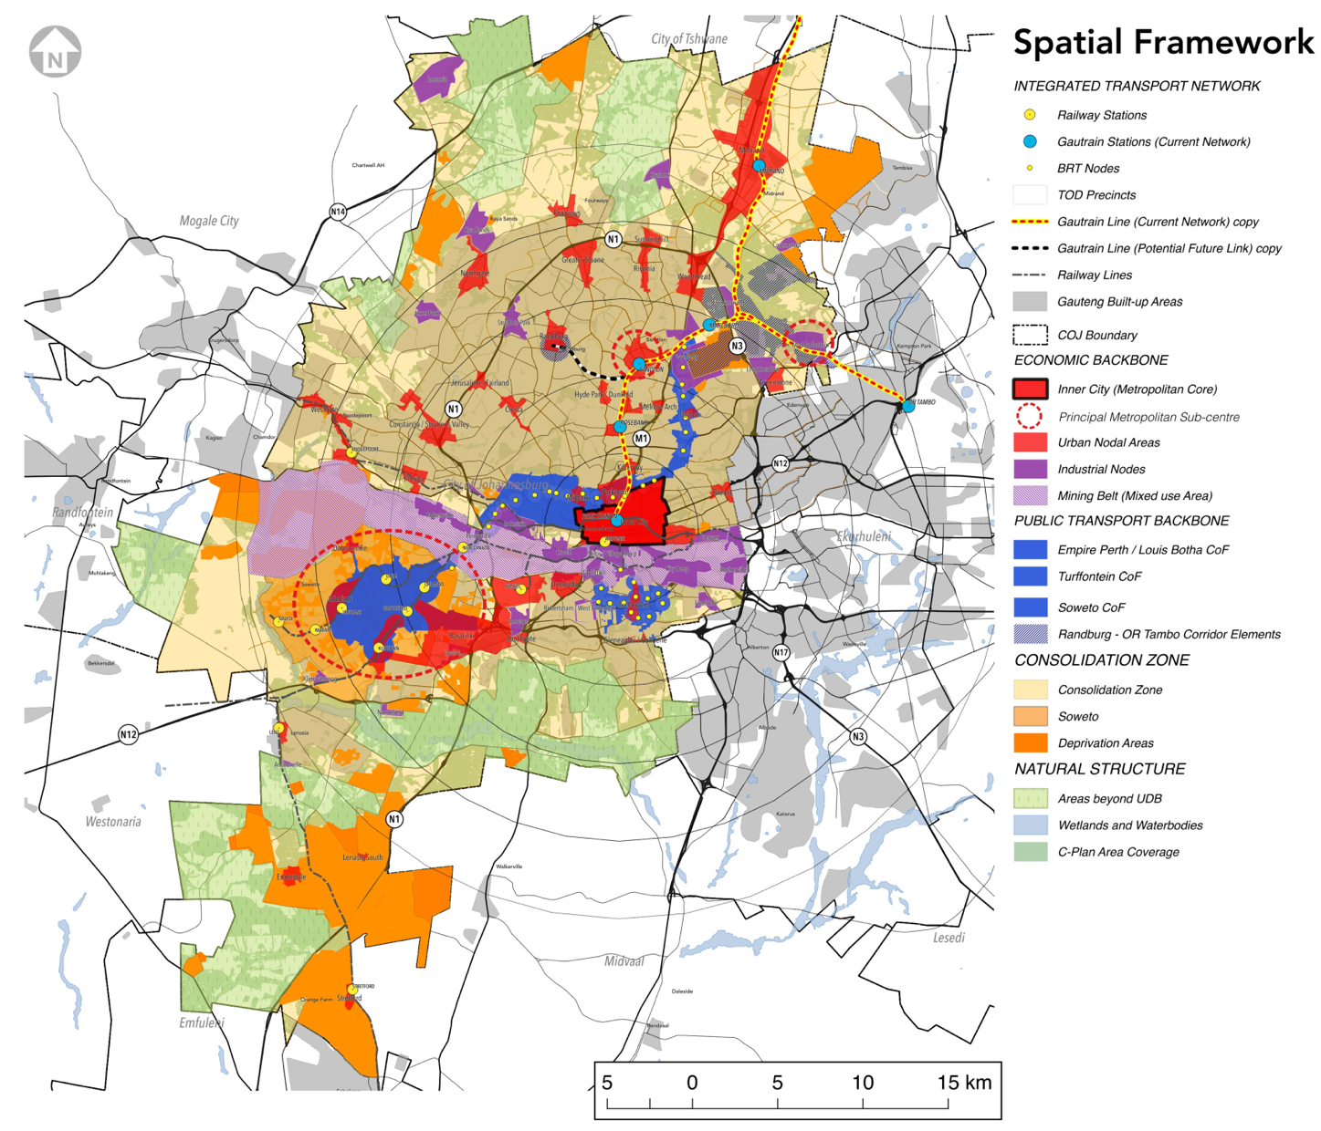
City of Johannesburg Spatial Development Framework
Spatial Development Frameworks are a requirement of the Spatial Planning and Land Use Management Act, 2013 (Act 16 of 2013). This act presides over all land use and land development matters with South Africa

Slide 28
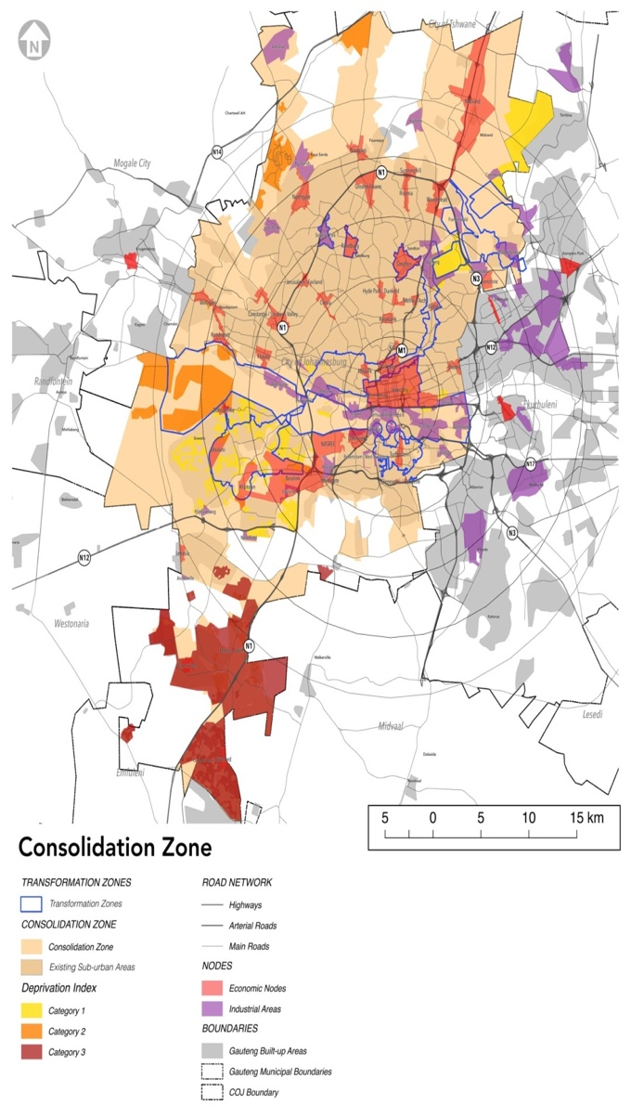
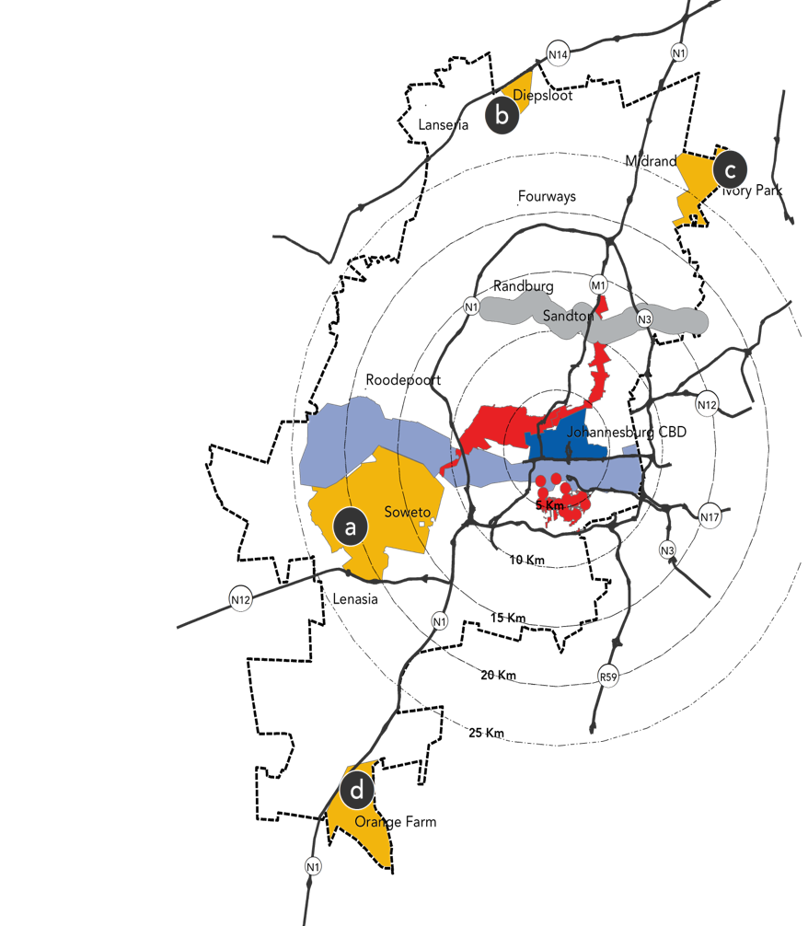
PRIORITY AREAS
A strong Metropolitan Core
At the heart of the future compact polycentric Johannesburg lies a strong metropolitan core, the CBD or Inner City
Transit Orientated Developments (TODs)
Consolidate appropriate growth and development opportunities around existing and future public transport nodes, starting with the TODs.
Soweto as a True City District
Transform Soweto into a liveable city district in its own right with access to jobs and the full array of urban amenities
Developing a Randburg – OR Tambo Corridor
This strategy will focus economic investment in well-connected centres and provide adequate space for economic growth.
Unlocking the Mining Belt
By exploiting its potential, this fragmenting feature could become one of inclusion
CONSOLIDATION ZONE
Deprivation Areas
Respond to existing marginalised areas to improve services and quality of life, through infrastructure and job creation
Only expand these areas when there is nearby economic activity or potential
Established low density suburbs
Increase inclusivity, connectivity and liveability. The city will allow new developments that promote the goals and meet the requirements of the SDF, but do not require extensive bulk infrastructure upgrades.

Slide 29
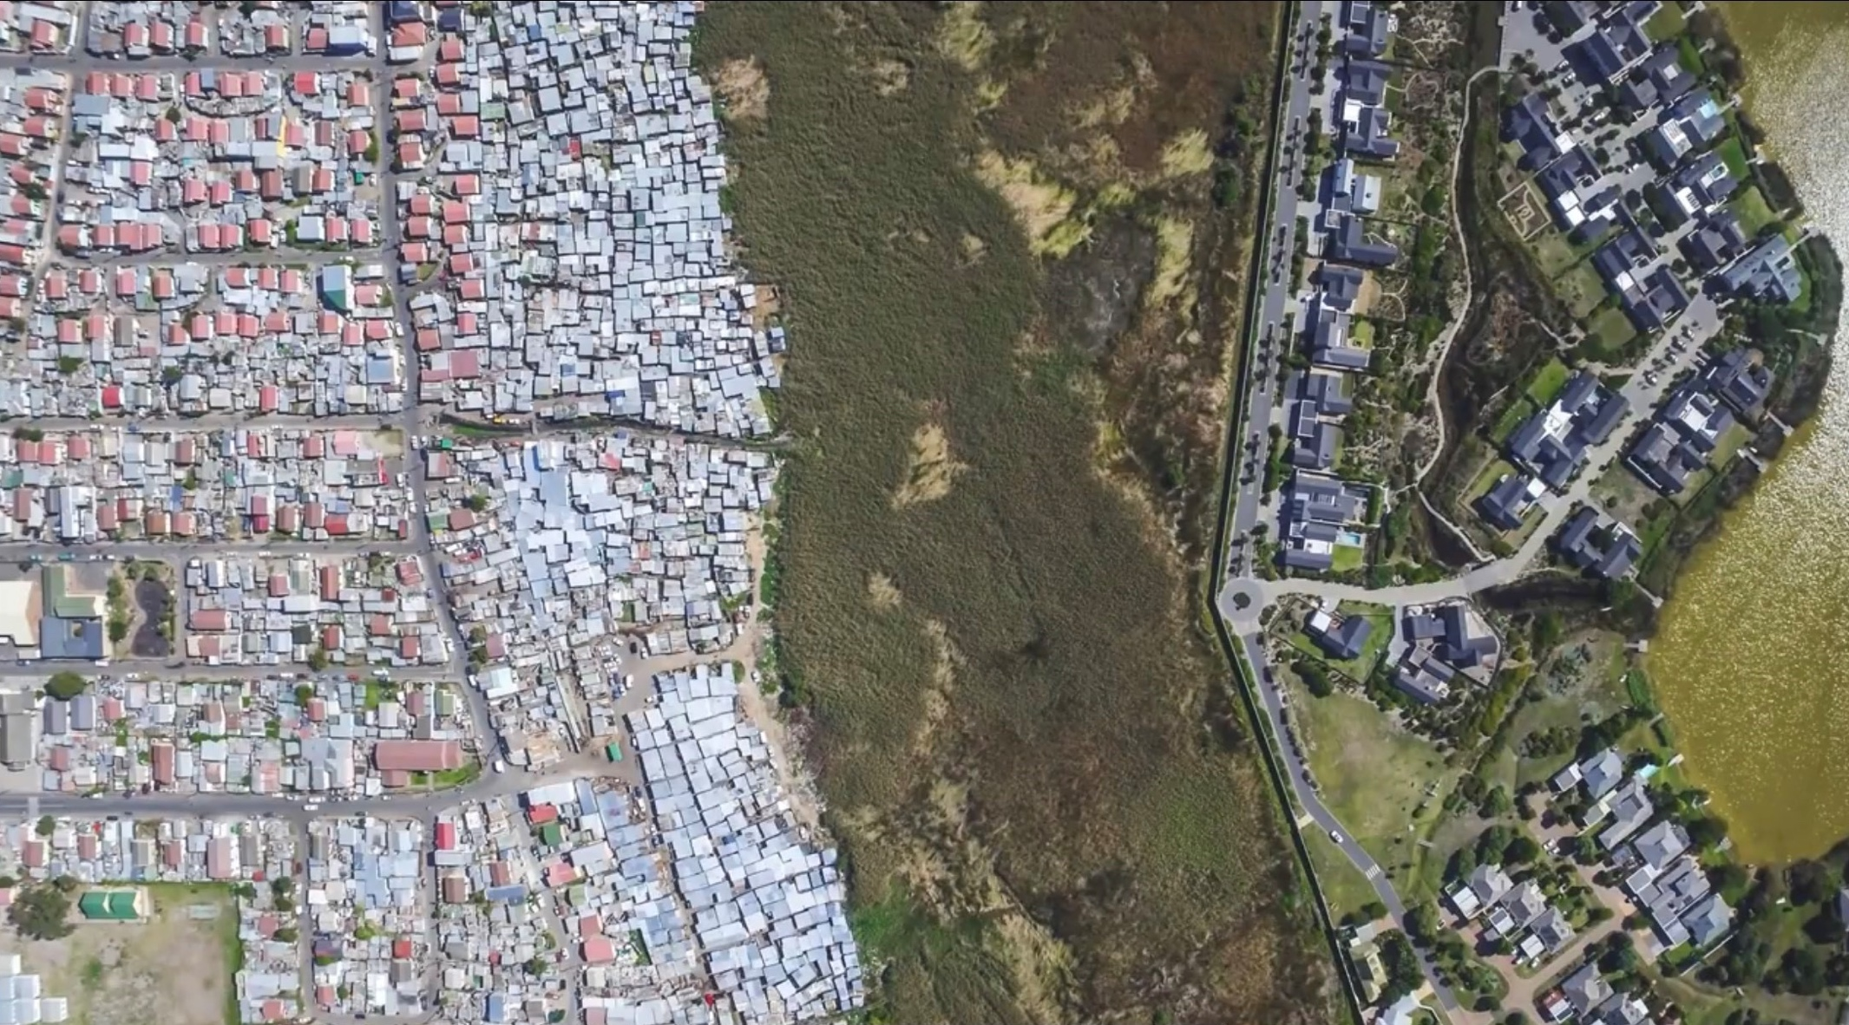
By Jonny Miller http:llyoutube/lpfMMKT_4jw

Slide 30
Conclusion
A system-level approach is critical for integration in the government space
Resilient communities need comprehensive outcomes for sustainability
Re-articulate the role of government - lessons from the Pandemic

Slide 31
COMMONWEALTH SUSTAINABLE URBANISATION PROGRAMME INFRASTRUCTURE-LED COMMUNITY RESILIENCE
Hosted by
The Commonwealth Engineers Council
UNESCO
Institution of Civil Engineers
Dr Juliet Mian
Deputy Executive Director, The Resilience Shift, UK

Slide 32
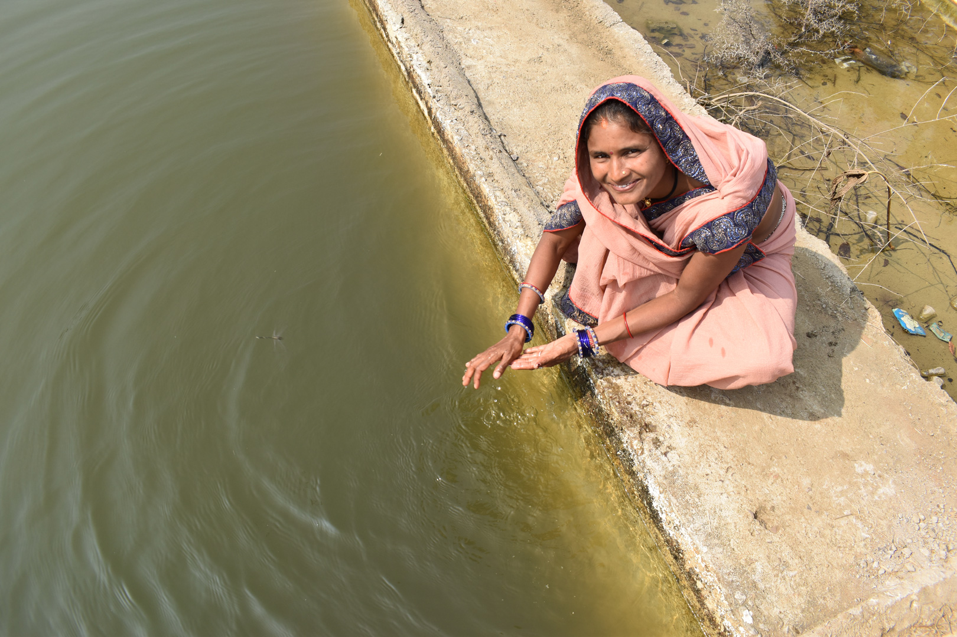
Resilience success story – ICRG India (Infrastructure for Climate Resilient Growth, supported by DfID/MGNREGA)
A resilience success story – ICRG India
The Infrastructure for Climate Resilient Growth programme.
Supported by:
- UK Department for International Development (DfID)
- Mahatma Gandhi National Rural Employment Guarantee Act (MGNREGA).
Notes:
The Resilience Shift wants to share good work by others, in this case, a technical assistance project supported by the UK’s Department for International Development (DFID). This case study tells the story of what good practice looks like for resilient infrastructure.
This is a story of infrastructure creation that does not begin with the asset. It begins instead with the people; specifically, the needs of some of the poorest and the most vulnerable in rural India.
A technical assistance project in India has initiated over 900 climate resilient infrastructure projects in just 4 years. The DFID-supported, Infrastructure for Climate Resilient Growth in India (ICRG) programme, is active across 22 districts in three Indian states, Bihar, Chhattisgarh, and Odisha
ICRG connects resilient infrastructure with social protection to build community resilience. It links with India’s largest social security programme, the Mahatma Gandhi National Rural Employment Guarantee Act (MGNREGA). The MGNREGA, is a wage-for-labour programme, has deployed $25 billion as wage payments to rural households in over 13,000 villages.
Under the ICRG programme, climate resilient works are built by local communities. The programme has provided training to over 10,000 people to ensure the infrastructure delivers resilience benefits.
ICRG has used technology and climate data to inform asset selection delivered through mobile phone applications.
Over 8 out of 10 climate resilient works built under the ICRG project have been geo-tagged, creating a digital database and asset map that helps state level officials track existing assets and plan new ones.

Slide 33
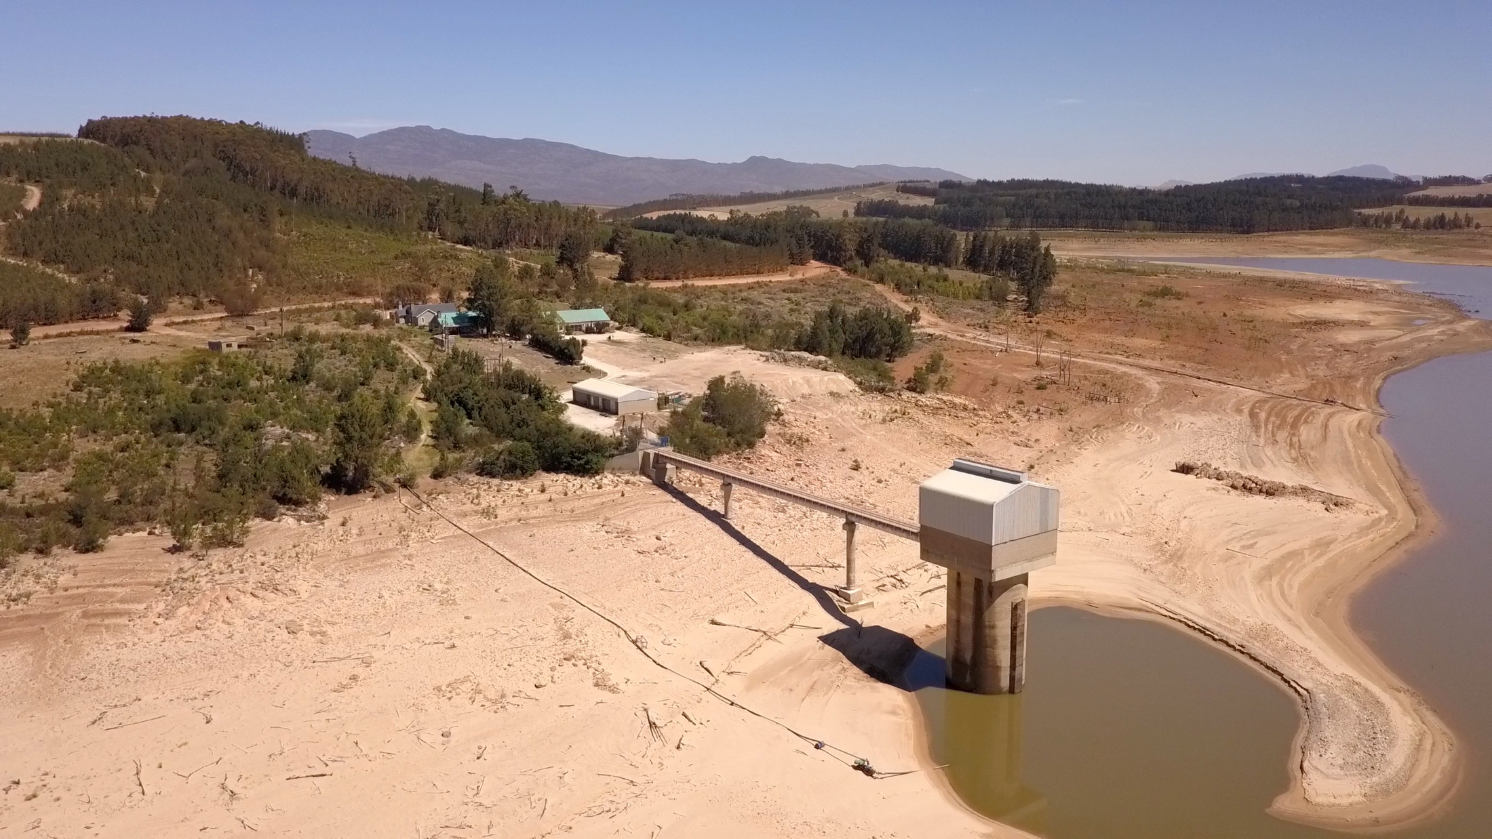
Cape Town: learning from Day Zero
Cape Town Day Zero: learning from crisis
Notes:
As part of our work on making resilience tangible, practical and relevant, we have supported the development of film-based learning modules that consolidate reflections from key individuals involved in the response to the 2017-18 water crisis in Cape Town.
Following three consecutive years of poor rainfall, the city of Cape Town was in the midst of a severe water crisis. The city of 4 million people was projected to run out of water on 12 April 2018 – 'Day Zero'. A collective response from the residents of Cape Town helped avert this crisis.
There are many lessons to be learned from Cape Town’s water crisis about city governance, the management of water resilience, the importance of multi-stakeholder response, and the impact of an emergency on consumer behaviour.

Slide 34
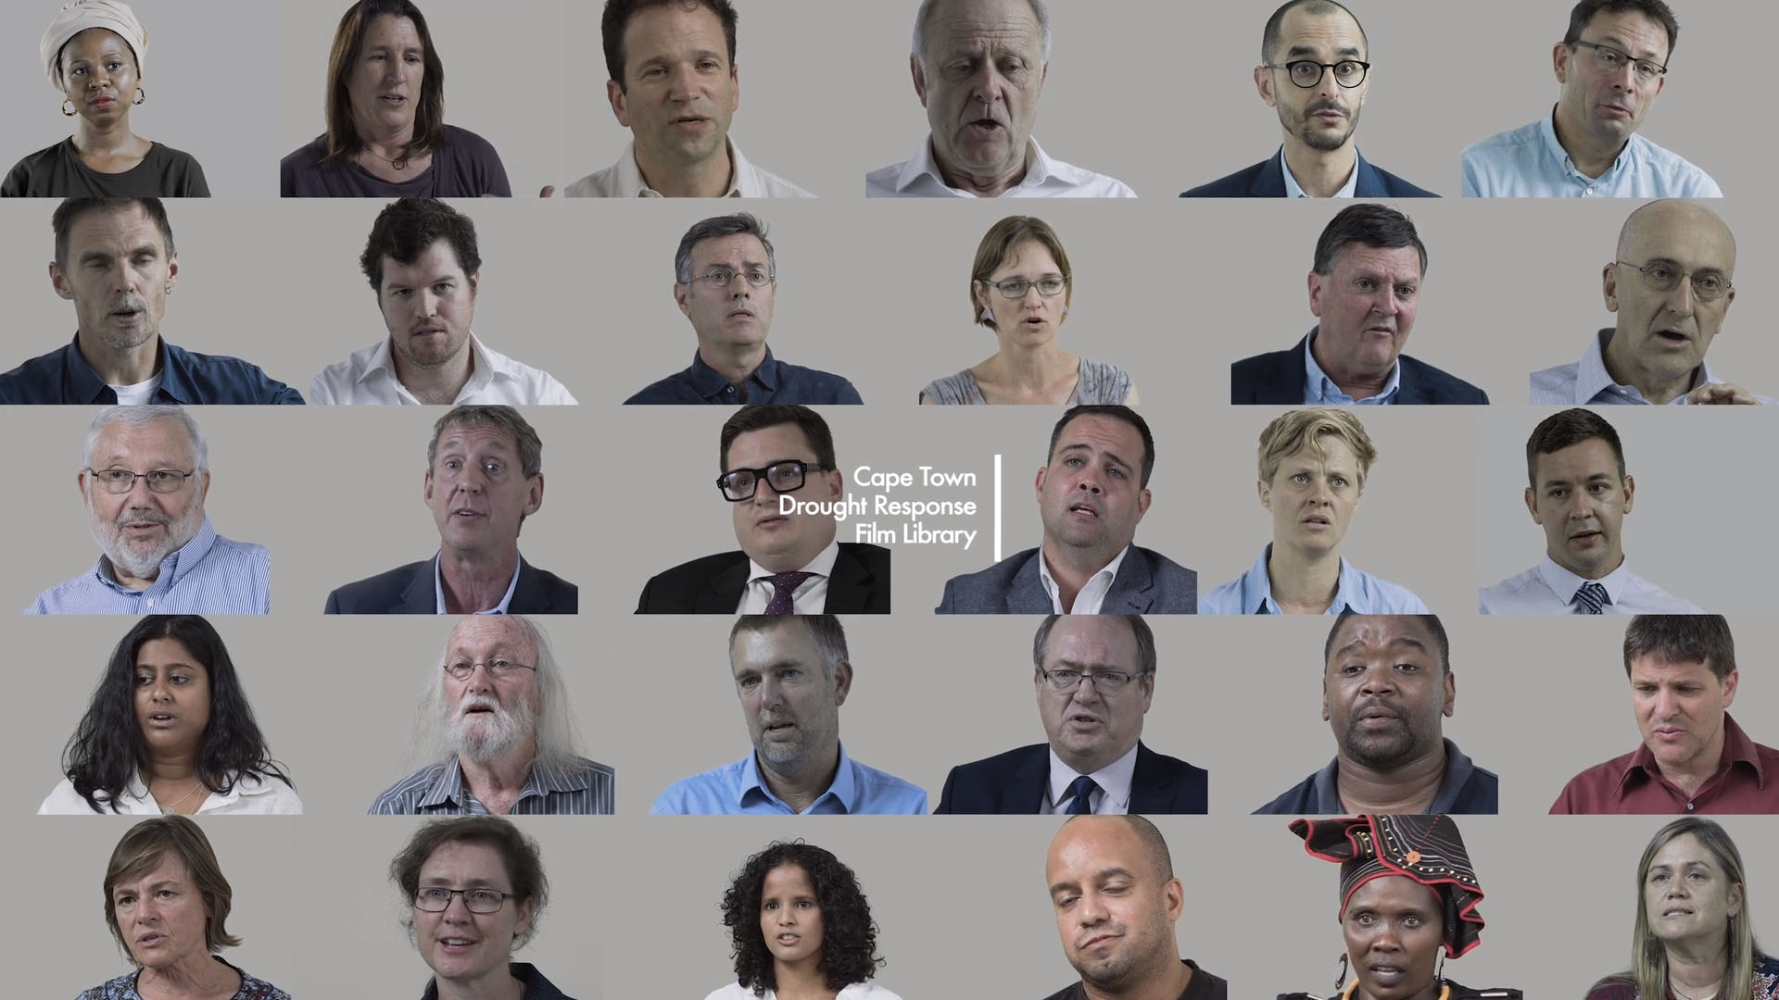
Cape Town: learning from Day Zero
Notes:
The Cape Town Drought Response Learning Initiative (CTDRLI) has documented analyses and reflections of key individuals involved in the drought response, through in-depth filmed interviews.
The Resilience Shift has partnered with the CTDRLI to distil learnings from these filmed interviews into a modular toolkit of lessons. These lessons can be used by decision-makers to reflect on critical infrastructure resilience in their own cities – to better prepare for a crisis, and to craft a better response when a crisis does hit.
This project aims to promote systems thinking within cities, water companies and other stakeholders through informed reflection on the Cape Town case study. By articulating the interplay of social and environmental factors with critical infrastructure systems in an engaging format, the project aims to deepen an understanding of the multidimensional and complex dynamics – technical, financial, social, political, regulatory, fiscal, environmental – of infrastructure systems, particularly when under stress.

Slide 35
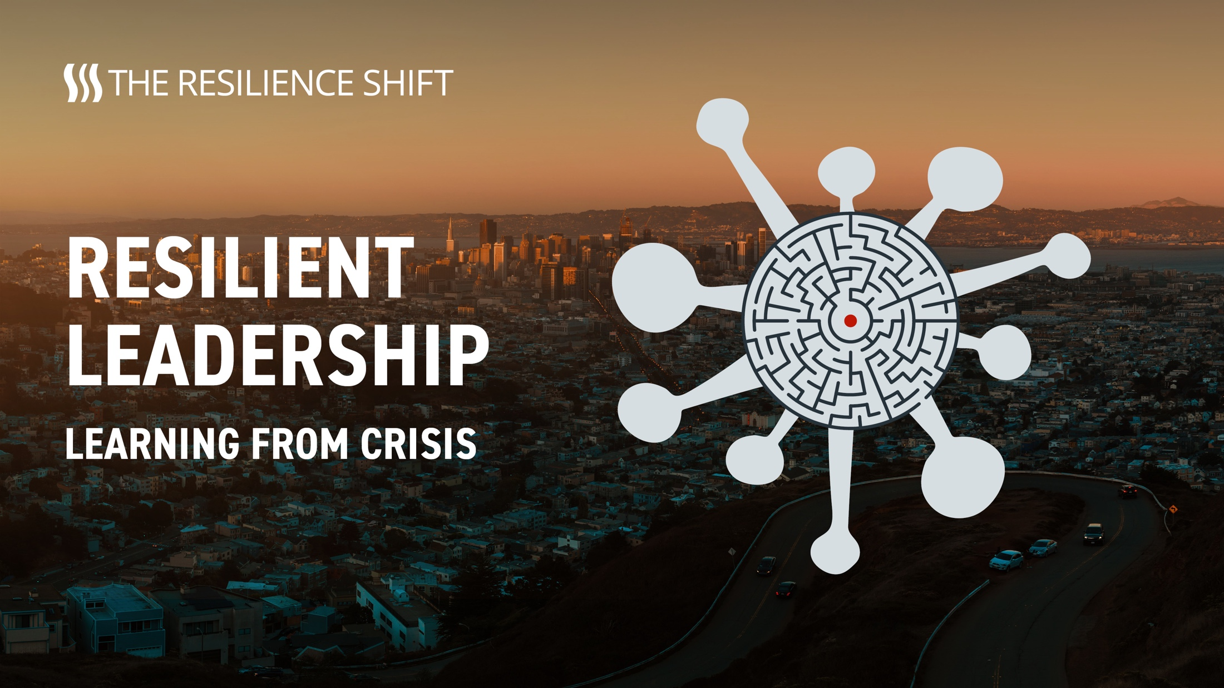
Learning from crisis: resilient leadership
Notes:
As part of our work to make resilience tangible and relevant, every week for four months through the Covid-19 pandemic we are interviewing the same twelve senior decision-makers and professionals for their evolving reflections on what they are encountering.
What makes a good leader? Leaders are being asked to make difficult decisions with the challenges of the coronavirus outbreak. But how can they be sure they are making the right decision and remain resilient when faced with such challenges? And how can leaders form these critical decision-making skills before a crisis or disaster happens?
A new initiative by The Resilience Shift, in partnership with the Global Resilient Cities Network, is shining the light on resilient leadership as part of its work to make resilience tangible and relevant.
Seven of the participants are senior executives in significant corporations like Arup, the Lloyd’s Register Group, We Are Optima, SAP, Siemens, the World Bank and WSP, and five are the Chief Resilience Officers of a major city in Europe, Africa, India, Brazil and the US, members of the Global Resilient Cities Network.
Detailed insights distilled from weekly interviews with senior leaders, and a weekly podcast series, with reflections on these insights, are now available from a new Resilient Leadership project, part of a series of research ventures by The Resilience Shift entitled ‘Learning from Crisis’. A report will be produced in September.

Slide 36
COMMONWEALTH SUSTAINABLE URBANISATION PROGRAMME INFRASTRUCTURE-LED COMMUNITY RESILIENCE
Hosted by
The Commonwealth Engineers Council
UNESCO
Institution of Civil Engineers
Dr Josh Macabuag
Disaster Risk Engineer, Independent Consultant, UK

Slide 37
Josh’s PPT Presentation – separate file

Slide 38
INFRASTRUCTURE-LED COMMUNITY RESILIENCE
Questions?
The Challenge we face – Scaling it up…
Notes:
Possible questions?
How can we mobilise the professions in the Commonwealth?
What is the role of ‘para professionals’?
In a post Covid world, can we connect young professionals in the Zoom Room?
What is the role of the diaspora? And why is there a diaspora at all?
When people talk about systems of systems and digital twins, why are they stuck inside their technical bubble and don’t realise some of the systems they need to connect are social and environmental?
How do we develop the social-environmental infrastructure nexus?
“How do I Effect Change?”
Persuade your boss’s boss!”
It’s recursive algorithm!

Slide 39
INFRASTRUCTURE-LED COMMUNITY RESILIENCE
Next Steps??
The Challenge we face – Scaling it up…

Slide 40
INFRASTRUCTURE-LED COMMUNITY RESILIENCE
Thank You!
“Now is the time for an infrastructure-led response to the UN SDGs”
Time is not on our side… But we are!

